Slide 1
MySQL
DATE, TIME, DATETIME

Slide 2
DATE

Slide 3
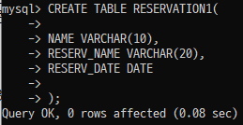

Slide 4
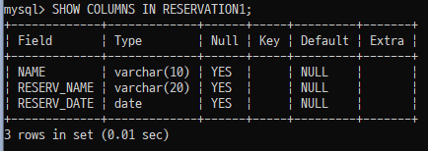

Slide 5
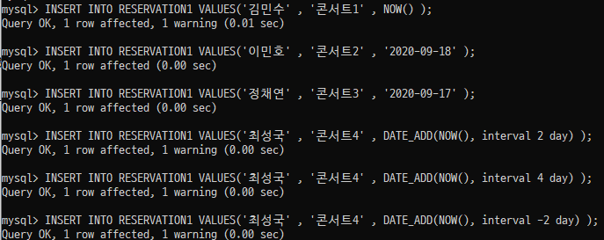

Slide 6
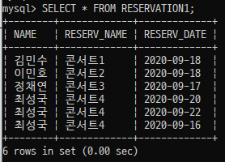

Slide 7


Slide 8


Slide 9


Slide 10
TIME

Slide 11
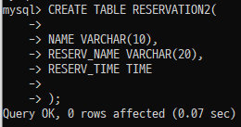

Slide 12
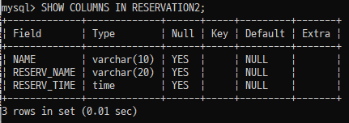

Slide 13
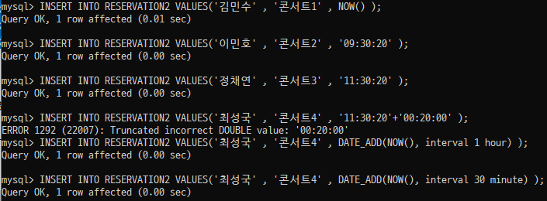

Slide 14
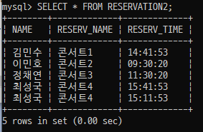

Slide 15


Slide 16


Slide 17
DATETIME

Slide 18
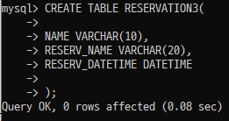

Slide 19


Slide 20
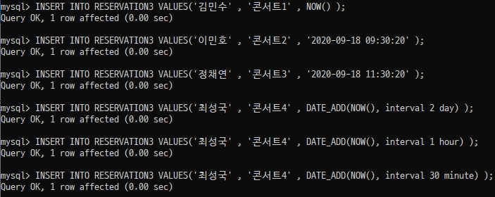

Slide 21
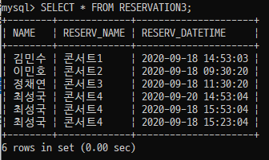

Slide 22


Slide 23


Slide 24


Slide 25
끝

